Slide 1
Personal Learning: Taking Ownership of Learning Online – Part 7
Stephen Downes
December 7, 2020
https://www.downes.ca/presentation/531

Slide 2
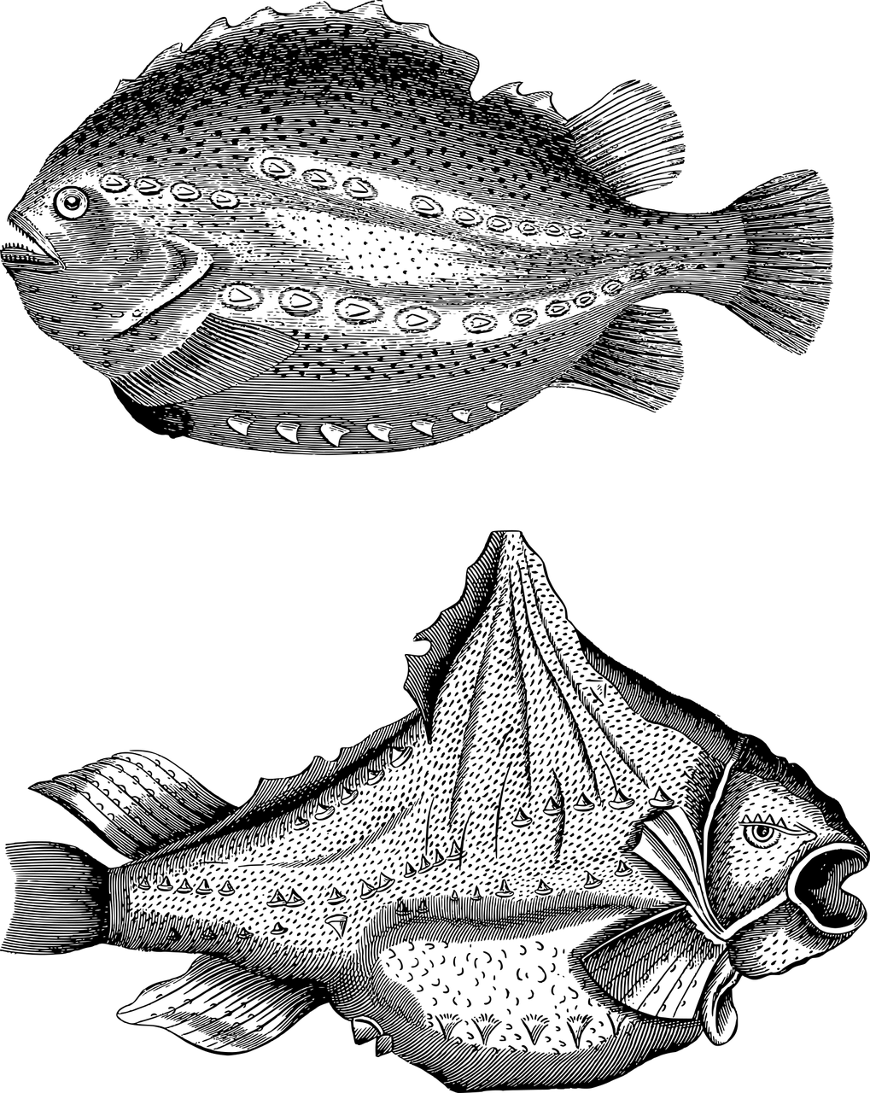
Topics for Discussion - Practical
Part One: Relevance and Usability y
Starting points y
Supporting them when they’re not supported y
https://www.downes.ca/presentation/525
Part Two: Interactivity y
Starting points y
Supporting them when they’re not supported y
https://www.downes.ca/presentation/528

Slide 3
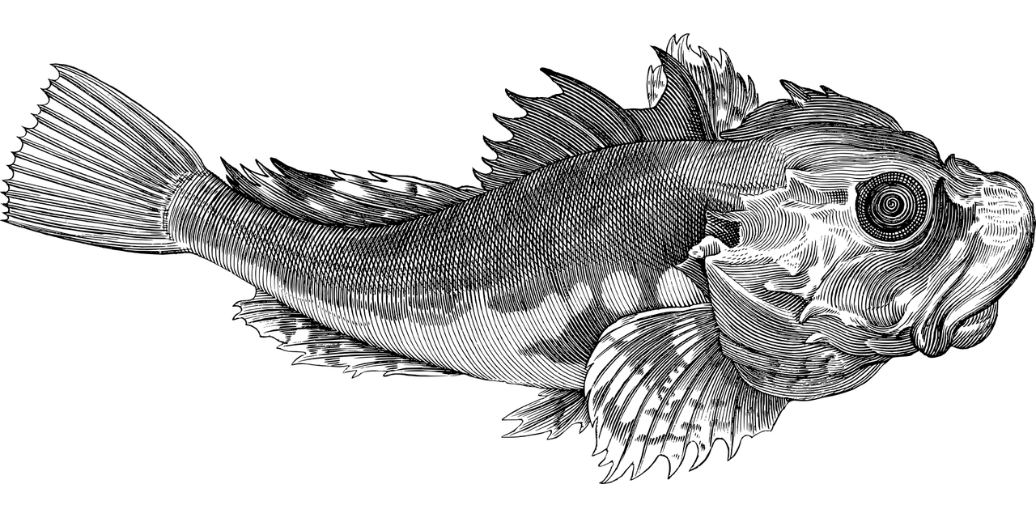
Topics for Discussion - Theory
Part Three: Personal Learning y
What is personal learning? y
Elements of personal learning y
https://www.downes.ca/presentation/530
Part Four: Supporting Personal Learning
Personal learning starting points - 1
https://www.downes.ca/presentation/531
Part Five: Supporting Personal Learning
Personal learning starting points - 2
Supporting personal learning online:
- Learning objectives
https://www.downes.ca/presentation/532

Slide 4
Topics for Discussion - Theory
Part Six: Supporting Personal Learning
- Forming Networks
https://www.downes.ca/presentation/535
Part Seven: Supporting Personal Learning Online

Slide 5
Supporting Personal Learning Online

Slide 6
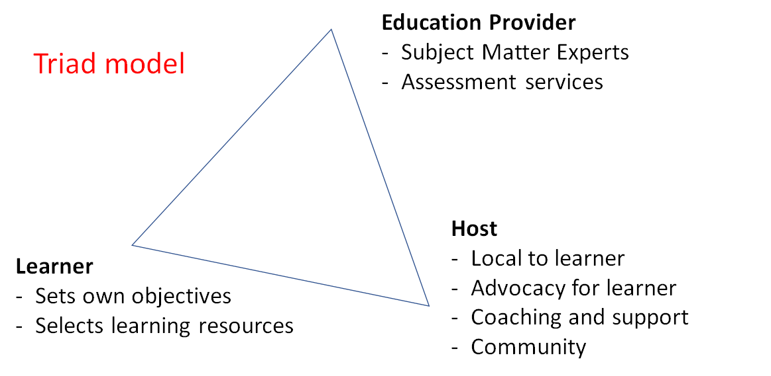
Online Host-Provider Framework

Slide 7
Online Host-Provider Framework

Slide 8
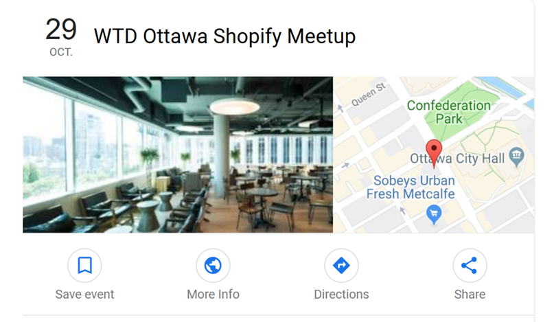
Online Host-Provider Framework
Community Learning Centres
Image: Google Events
https://www.google.com/search?client=firefox-b-d&q=shopify+ottawa+meetups&ibp=htl;events

Slide 9
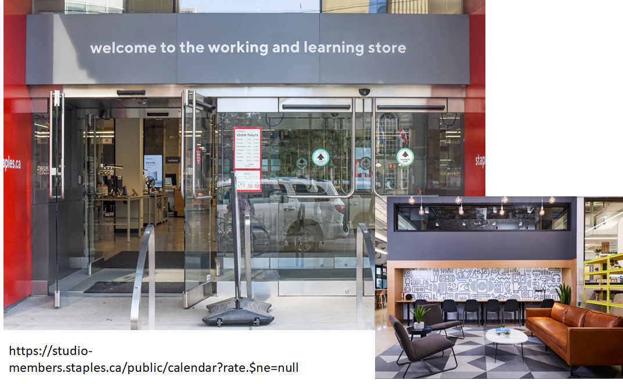
Online Host-Provider Framework

Slide 10
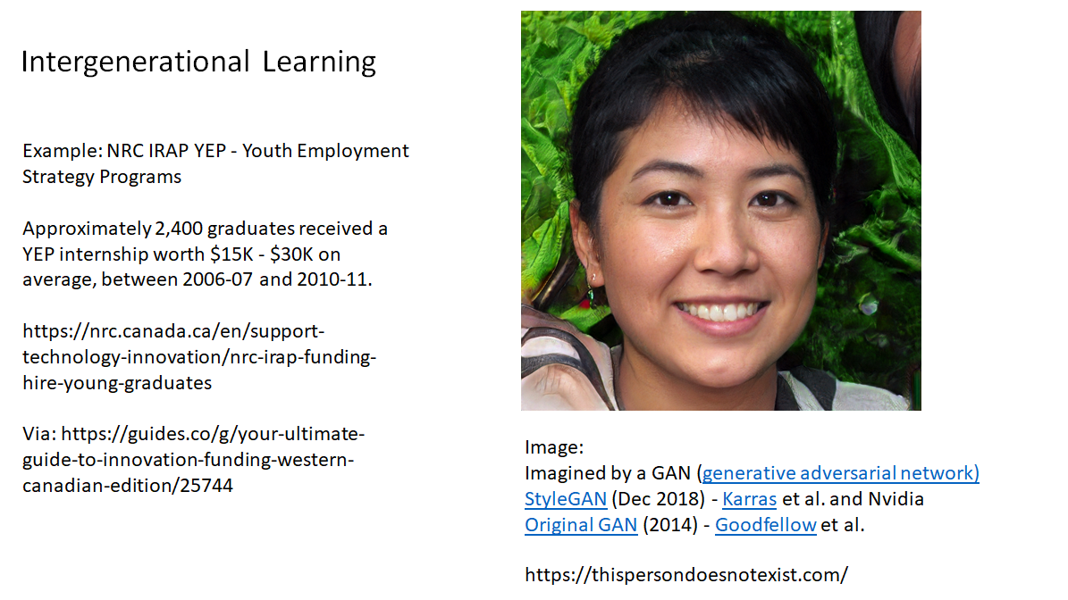
Education Providers...

Slide 11
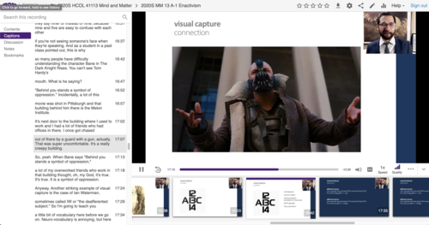
Education Providers...
Teaching from Home
Creating an Online Community, Class or Conference - Quick Tech Guide - http://bit.ly/quicktechguide

Slide 12
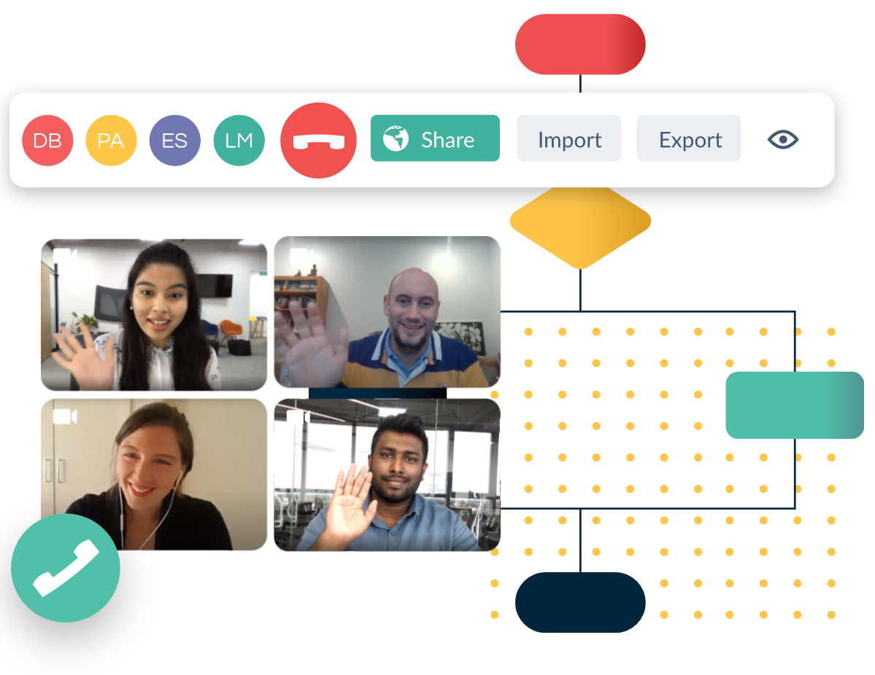
Education Providers...
Collaborative Tools
For example, Creately, a web-based tool that allows users to collaboratively create designs using a common interface.
https://creately.com/

Slide 13
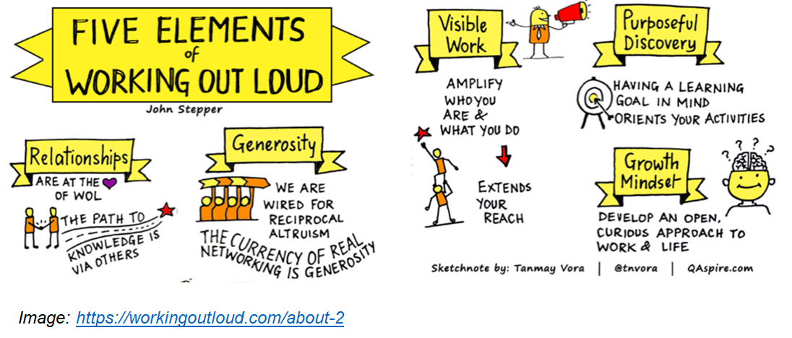
Education Providers...

Slide 14
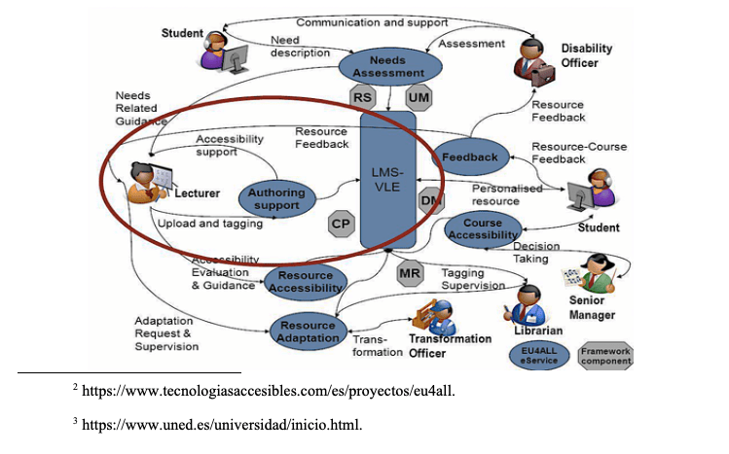
Education Providers...
OERs
Support for community in the development, discovery, use and sharing of open educational resources
Accessible Open Educational Resources and Librarian Involvement
Silvana Temesio, International Journal of Open Educational Resources. https://www.ijoer.org/accessible-open-educational-resources-and-librarian-involvement/

Slide 15
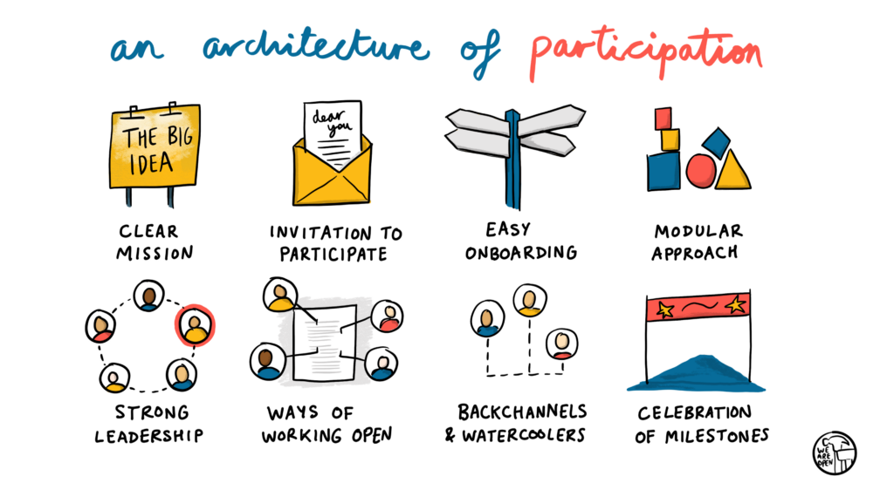
Education Providers...
Doug Belshaw - https://blog.weareopen.coop/howto-create-an-architecture-of-participation-for-your-open-source-project-a38386c69fa5

Slide 16
Stephen Downes
https://www.downes.ca

